Slide 1
Decision Making, Branching
Switch and Break

Slide 2
The switch Statement
switch is a control statement in C that allows you to execute one block of code out of many options, based on the value of an expression.
It’s like a cleaner alternative to writing multiple if-else statements.

Slide 3
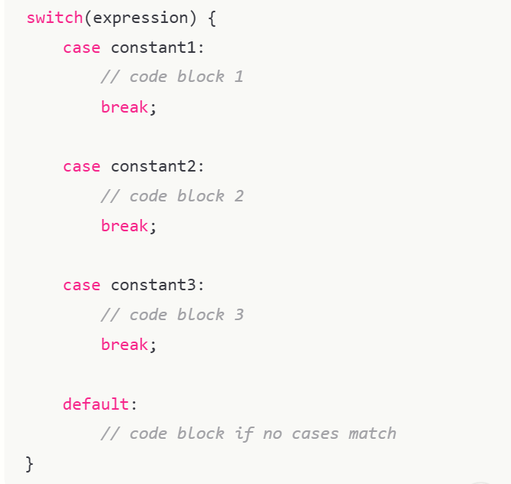

Slide 4
Points to Remember:
The expression inside switch must evaluate to an integer or character (not float/double).
case labels must be constant values.
break; is used to transfer control out of the switch
Without break, execution “falls through” to the next case.
default is optional and runs if no case matches

Slide 5
The switch statement
The expression is successively compared against the values value1, value2, ..., valuen. If a case is found whose value is equal to the value of expression, the program statements that follow the case are executed.
switch ( expression )
{
case value1:
program statement
program statement
...
break;
case value2:
program statement
program statement
...
break;
case value n:
program statement
program statement
...
break;
default:
program statement
program statement
...
}
The switch test expression must be one with an integer value (including type char) (No float !).
The case values must be integer-type constants or integer constant expressions (You can't use a variable for a case label !)

Slide 6
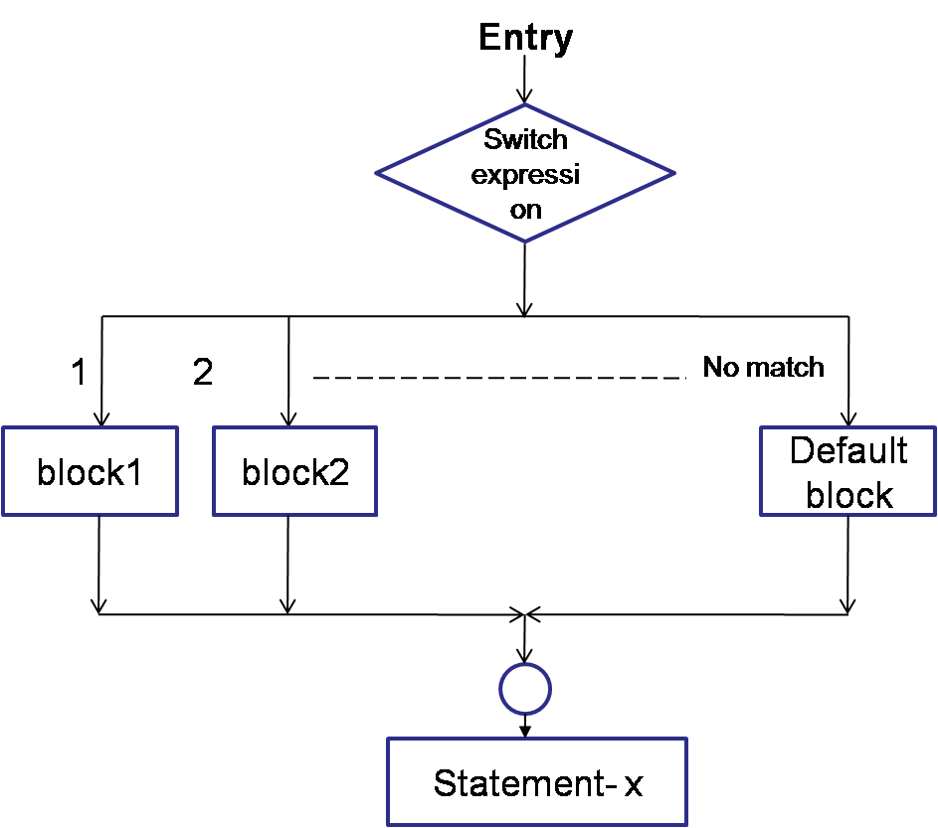
switch- control flow
Notes:
Evaluates the (expression) and compares its integer or character value
with the values following each case label.
1. If a match is found between (expression) and one of the values, execution is transferred to the statement(s) that follows the case label.
2. If no match is found, execution is transferred to the statement(s) following the optional default label.
3. If no match is found and there is no default label, execution passes to the first statement following the switch statement closing brace, the next_statement.
4. To ensure that only the statements associated with the matching template are executed, include a break statement where needed, which terminates the entire switch statement.
5. As usual the statement(s) can also be a block of code put in curly braces.

Slide 7
switch- example 1
#include<stdio.h>
int main()
{
int choice;
printf(“Enter your choice: 1-yes, 2-no\n”);
scanf(“%d”,&choice);
switch(choice)
{
case 1: printf(“YESSSSSSS……”);
break;
case 2: printf(“NOOOOOO……”);
break;
default: printf(“DEFAULT CASE…….”);
} printf(“The choice is %d”,choice);
return 0;
}

Slide 8
switch- example 2
scanf(“%d”,&mark);
switch (mark)
{
case 100:
case 90:
case 80: grade=‘A’;
break;
case 70:
case 60:
grade=‘B’;
break;
case 50:
grade=‘C’
break;
case 40:
grade=‘D’
break;
default: grade=‘F’;
break;
}
printf(“%c”,grade);

Slide 9
An Example – switch case
char ch;
scanf)(“%c”,&ch);
switch(ch)
{
case ‘a’ : printf(“Vowel”); break;
case ‘e’ : printf(“Vowel”); break;
case ‘i’ : printf(“Vowel”); break;
case ‘o’ : printf(“Vowel”); break;
case ‘u’ : printf(“Vowel”); break;
default: printf(“Not a Vowel”); }

Slide 10
An Example – switch case
char ch;
scanf(“%c”,&ch);
switch(ch)
{
case ‘a’:
case ‘e’:
case ‘i’ :
case ‘o’ :
case ‘u’ : printf(“Vowel”); break;
default: printf(“Not a Vowel”); }

Slide 11
Example - switch
/* Program to evaluate simple expressions of the form value operator value */
#include <stdio.h>
int main (void)
{ float value1, value2;
char operator;
float result;
printf("Type in your expression.\n“);
scanf(“%f %c %f”, &value1,&operator,&value2);
switch (operator)
{case '+':
result=value1+value2;
printf(“%f”,result);
break;
case '-': result=value1-value2;
printf(“%f”,result);
break;
case ‘*': result=value1*value2;
printf(“%f”,result);
break;
case ‘/': if ( value2 == 0 )
printf(“Division by zero.\n“);
else result=value1 / value2;
printf(“%f”,result);
break;
default;
printf(“Unknown Operator”);
}
return 0;
}

Slide 12
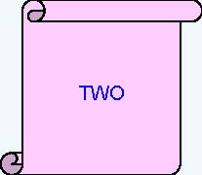
What is the output of the following code snippet?
int iNum = 2;
switch(iNum)
{
case 1:
printf(“ONE”);
break;
case 2:
printf(“TWO”);
break;
case 3:
printf(“THREE”);
break;
default:
printf(“INVALID”);
break;
}

Slide 13
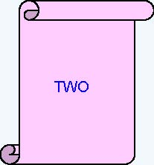
What is the output of the following code snippet?
iNum = 2;
switch(iNum)
{
default:
printf(“INVALID”);
case 1:
printf(“ONE”);
case 2:
printf(“TWO”);
break;
case 3:
printf(“THREE”;)
}

Slide 14
What is the output of the following code snippet?
switch (iDepartmentCode)
{
case 110 : printf(“HRD ”);
case 115 : printf(“IVS ”);
case 125 : printf(“E&R ”);
case 135 : printf(“CCD ”);
}
Assume iDepartmentCode is 115
find the output ?
IVS E&R CCD

Slide 15
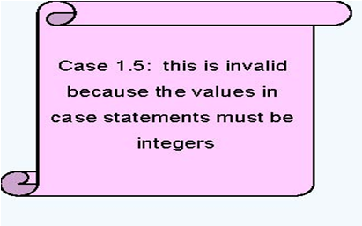
What is the output of the following code snippet?
int iNum = 2;
switch(iNum)
{
case 1.5:
printf(“ONE AND HALF”);
break;
case 2:
printf(“TWO”);
case ‘A’ :
printf(“A character”);
}

Slide 16
Check Validity:
switch(1+2+23)
switch(1*2+3%4)
switch(a*b+c*d)
switch(a+b+c)
Important Points:
Duplicate case values are not allowed
Nesting of switch statements is allowed

Slide 17
int main()
{
int x = 1;
switch (x)
{
x = x + 1;
case 1: printf("Choice is 1");
break;
case 2: printf("Choice is 2");
break;
default: printf("Choice other than 1 and 2");
break;
}
return 0;
}
Output:: Choice is 1

Slide 18
int main()
{
int x = 1;
switch (x)
{
case 2: printf("Choice is 1");
break;
case 1+1: printf("Choice is 2");
break;
}
return 0;
}
Output::
Compiler Error: duplicate case value

